Slide 1

Notes:
Introduction about FACE

Slide 2


DECISION MAKING 1.2
Types of Decision Making, Decision Making Conditions
Sub-Topic (Example: name of college)
Notes:
Trainers,
Ask the students,
Is the decision taken by the students for personal reasons same as that of official reasons? The decision varies from situation to situation.
Sometimes, decision making will not be an individual constraint. Group decisions are to be taken.
In work places, there are so many different situations for making decisions.
We are going to discuss on these in the upcoming slides.
Ask the students, in their day to day life, what are the situations they have to decide individually and what are the situations they have to combine and collaborate and make decisions.
The second sub topic is Decision Making Conditions. They are Certainty, Risk and Uncertainty Conditions. Those are discussed in the slides related to the sub topic. Please go through it and understand.

Slide 3

AGENDA
1. Types of Decision Making
2. Decision Making Conditions
Notes:
We have covered the following in Decision Making 1.1
Introduction – Decision Making
Understanding the Process of Decision Making
Identifying the Importance of Decision Making
We are going to cover the following topics in this session
1. Types of Decision Making
2. Decision Making Conditions

Slide 4
Types of Decision Making
Routine Decision Making
Basic Decision Making
Personal Decision Making
Organizational Decision Making
Individual Decision Making
Group Decision Making
Notes:
Trainer to explain that we are going to look at the Types of Decision Making, one by one in the upcoming slides

Slide 5
Types of Decision Making
Operating Decision Making
Policy Decision Making
Programmed Decision Making
Non-Programmed Decision Making
Planned Decision Making
Unplanned Decision Making
Notes:
Trainer to explain that we are going to look at the Types of Decision Making, one by one.

Slide 6
Types of Decision Making
Tactical Decision Making
Strategic Decision Making
Departmental Decision
Inter Departmental Decision Making
Notes:
Trainer to explain that we are going to look at the Types of Decision Making, one by one.

Slide 7

Routine Decision Making
Routine decision making : Day to day activities of the organization which require less thinking and advise.
Notes:
Routine Decision Making means such decisions, which are taken in respect of the day to day activities of the organization, and which require less thinking and advise. These are of a repetitive nature.

Slide 8

Basic Decision Making
Basic decision making : Essential for the existence of the organization and for which complete study, analysis, power, and critical thinking are essential.
Notes:
Basic Decision Making means such decisions which are essential for the existence of the organization and for which complete study, analysis, power, and critical thinking are essential.

Slide 9

Personal Decision Making
Personal Decisions are taken by any person in his personal capacity, and not as a member of the organization
Notes:
The decisions which are taken by any person in his personal capacity, and not as a member of the organization are known as Personal Decisions, for example, decisions for leave, resigning from the organization and accepting or rejecting promotions, etc.

Slide 10

Organizational Decision Making
Organizational decisions are taken by the executives or officers in their formal capacity
Notes:
The organizational or institutional decisions are taken by the executives or officers in their formal capacity and which may be delegated to other persons.

Slide 11

Individual Decision Making
Individual Decisions are taken by the managers in small units
Notes:
When the size of the business unit is small and the decisions to be taken do not require high, specific and technical knowledge, then the decisions are normally taken by the managers themselves.
Such decisions are known as individual decisions.

Slide 12

Group Decision Making
Group Decisions are taken by a group
Notes:
Group decision making techniques mean such decisions which are not taken by a single individual, but by a group.
This is known as participating decisions.

Slide 13

Operating Decision Making
Operating decisions are related to the general affairs of the institution
Notes:
Operating decision making is in respect of decisions relating to the general affairs of the institution or enterprise and is of mechanical nature.
Such decisions making is also known as executive or current decision making because they are helpful in the execution of policy decisions.

Slide 14

Policy Decision Making
Policy decisions are related to the basic policies of the management
Notes:
Policy decisions are those which relate to the basic policies of the organization and these are taken by the top management or board of directors. Such decisions are also known as management decisions or basic decisions.

Slide 15

Programmed Decision Making
Programmed decision is one that is fairly structured or recurs with some frequency
Notes:
Programmed Decision Making
Programmed decision making is of repetitive and routine nature and which is taken through some well decided and well-organized system, so that when the problem arises, it may be solved by using that method.
Programmed decision is one that is fairly structured or recurs with some frequency (or both).
Many decisions regarding basic operating systems and procedures and standard organizational transactions fall into this category.
McDonald’s employees are trained to make the Big Mac according to specific procedures.
Starbucks, and many other organizations, use programmed decisions to purchase new supplies [coffee beans, cups and napkins].

Slide 16

Non-Programmed Decision Making
Non programmed decision is the one that is unstructured and occurs much less
Notes:
Non programmed Decision Making
Non Programmed decision making is not a routine or repetitive nature. These are unique and new and they have a long-lasting effect on the organization.
This decision making is based on traditional methods, and not on the pre decided procedure.
Non programmed decision is one that is unstructured and occurs much less.
Most of the decisions made by top managers involving strategy and organization design are non programmed. Decisions about mergers, acquisitions and takeovers, new facilities, new products, labor contracts and legal issues are non programmed decisions.
Managers faced with non programmed decisions must treat each one as unique, investing great amounts of time, energy and resources into exploring the situation from all views. Intuition and experience are major factors in these decisions.

Slide 17

Planned Decision Making
Planned decisions are advance preparation based on facts, analysis and scientific methods
Notes:
Decisions for which Advance preparation is done, an are based on the collection of facts, analysis and scientific methods are known as planned decision making.

Slide 18

Unplanned Decision Making
Unplanned decisions have no plan, but necessary according to the situations
Notes:
Unplanned decision making technique means such decisions for which no plan is made, but are necessary, according to the circumstances, problems and opportunities.

Slide 19

Tactical Decision Making
Tactical Decisions are routine in nature and the options are limited
Notes:
Tactical decision making is of routine nature, related to the normal day to day activities and is of relatively lesser significance.
For these decisions, the options are limited and do not require much analysis and evolution.

Slide 20

Strategic Decision Making
Strategic decisions are difficult to be taken and are related to the future of the whole organization
Notes:
Strategic decision making technique is those decisions, which are very difficult to be taken. This affects the future of the business and are related to the whole Organization.
In other words, these are the decisions, which are taken presently, but their primary effect is observed after sometime.

Slide 21

Departmental Decisions Making
Departmental decisions are taken by department managers.
Notes:
Departmental decision making is for those decisions which affect the operation of the whole department of an enterprise and its employees.
Such decisions are taken by department managers, chairman, or the management.

Slide 22

Interdepartmental Decisions Making
Interdepartmental decisions are taken by the higher authorities of two or more departments
Notes:
Interdepartmental decision making is for those decisions which are taken by the higher authorities/chairpersons/representatives of two or more departments of the organizations, after mutual deliberations.

Slide 23
Decision Making Conditions
Decision Making Conditions
Decision Making Under Certainty
Decision Making Under Risk
Decision Making Under Uncertainty
Notes:
Decision Making conditions:
Decision Making under Certainty
Decision Making under Risk
Decision Making under Uncertainty

Slide 24

Decision Making under certainty
Decision maker knows conditions and alternatives
Business – rarely allows such decision
Notes:
Trainer,
Explain each point individually.
A state of certainty exists when a decision maker knows, with reasonable certainty, what the alternatives are and what conditions are associated with each alternative.
Very few organizational decisions, however, are made under these conditions.
The complex and turbulent environment in which businesses exist rarely allows for such decisions.

Slide 25

Decision making under risk
Past experiences
Relevant information
Advice of others
One’s own judgment
Notes:
Trainer,
Explain each point individually.
A state of risk exists when a decision maker makes decisions under a condition in which the availability of each alternative and it’s potential payoffs and costs are all associated with probability estimate.
Decisions such as these are based on past experiences, relevant information, the advice of others and one’s own judgment.
Decision is ‘calculated’ on the basis of which alternative has the highest probability of working effectively. [union negotiations, Porsche’s SUV focus vs high-performance sports cars]

Slide 26
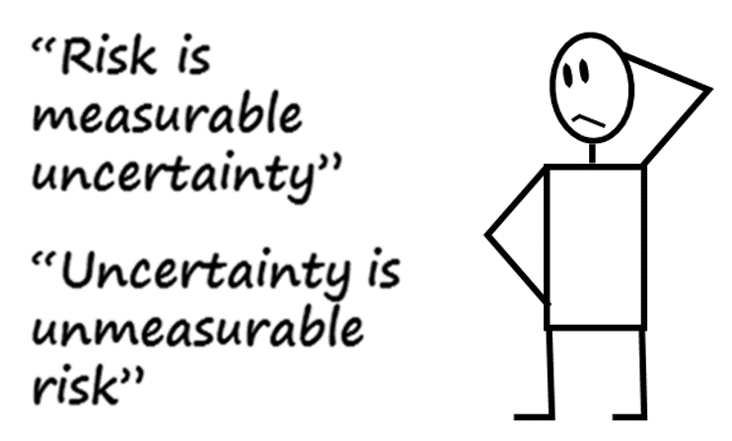
Decision making under uncertainty
Does not know all of the alternatives
Risks associated
Intuition
Judgment
Experience
Notes:
Trainer,
Explain each point individually.
A state of uncertainty exists when a decision maker does not know all of the alternatives, the risks associated with each, or the consequences each alternative is likely to have.
Most of the major decision making in today’s organizations is done under these conditions.
To make effective decisions under these conditions, managers must secure as much relevant information as possible and approach the situation from a logical and rational view.
Intuition, judgment and experience always play major roles in the decision making process under these conditions.

Slide 27
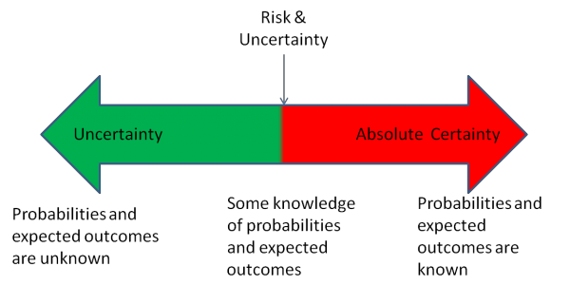
A view of Decision making conditions
Level of ambiguity and chances of making a basiLower Moderate Higher
Notes:
A view of decision making
Uncertainty : Probabilities and expected outcomes are unknown
Risk and Uncertainty : Some knowledge of expected outcomes and probabilities known
Absolute certainty: Probabilities and expected outcomes are known

Slide 28
1. Assume that an organization is going to shift its premises from urban to rural. What are the types of decision making can be involved in the following operations. 1. School for workers’ family 2. Departmentalization 3. Manufacturing unit 4. Recruitment of new employees 5. Conducting the opening ceremony
Activity
Notes:
Activity time : 10 minutes
Trainer to ask Students to take 5 minutes to write down what type of Decision Making the above come under. They need to justify their answers.
Discussion time : 5 minutes
Get the responses from the students
Encourage them to find out various Decision making types for the situations given and get the responses.
The below are the guidelines for the answers. The answers may vary. Appreciate all the answers. Observe their justification, ask why they have chosen that particular style for decision making.
Answers
1.Personal Decision Making / Group Decision making( workers can together discuss and decide)
2. Organizational Decision Making / Basic Decision Making / Policy Decision Making / Strategic Decision Making
3. Organizational Decision Making / Operational Decision Making /Departmental Decision Making / Programmed Decision Making / Planned Decision Making
Tactical Decision Making/
4. Organizational Decision Making / Inter departmental Decision Making /Operational Decision Making / Basic Decision Making
5. Organizational Decision Making / Group Decision Making

Slide 29


THANK YOU
Notes:
Trainer to thank the students saying that it was a good session and re- iterate the usefulness of the session.

